Slide 1
Headfirst into a website!
Day 1

Slide 2
Let’s create a website!

Slide 3
Starting out
In this and the next series of lectures, we will be aiming at creating a modern website with top class, professional design.
We will be cloning this website.
In this lecture, we will create the header.
To get started, download the resources for this project.
Create a resources folder and keep your css file here.
In the resource folder, create an image folder and move the downloaded resources here.

Slide 4

The header

Slide 5
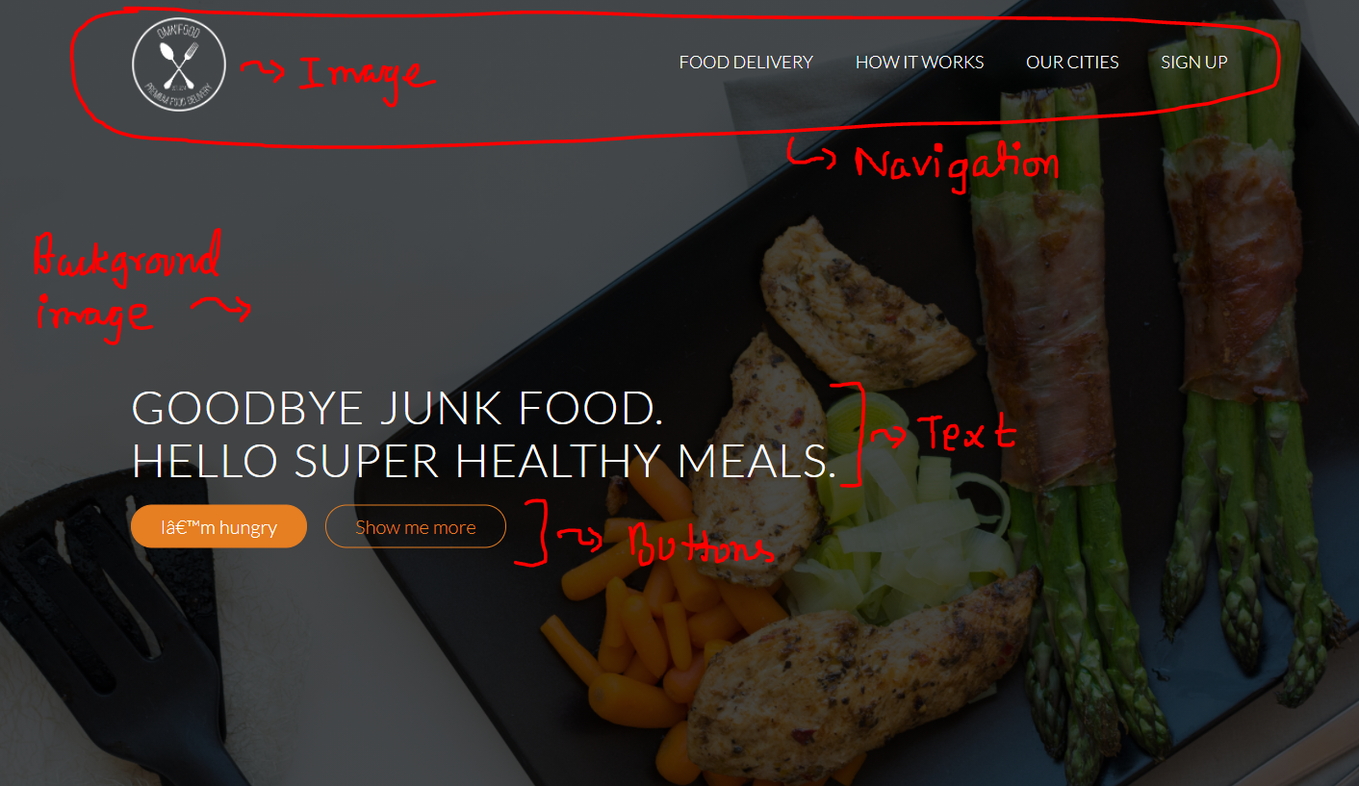
The header

Slide 6
Starting out: Semantic elements

Slide 7
The header
The previous picture highlights the parts of this section.
For this project, we will also be using semantic HTML.
“Semantic HTML” refers to the idea that all your HTML markup should convey the underlying meaning of your content—not its appearance.
There’s a whole set of elements designed for the sole purpose of adding more meaning to the overall layout of a web page. They’re called “sectioning elements”.

Slide 8
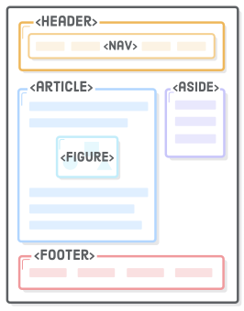
The header
The sectioning elements look something like this ->
Using these as an alternative to <div> elements is an important aspect of modern web development because it makes it easier for search engines, screen readers, and other machines to identify the different parts of your website.
It also helps you as a developer keep your site organized, which, in turn, makes it easier to maintain.

Slide 9
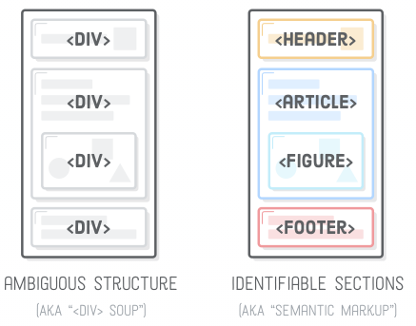
The header
See the difference -

Slide 10
The HTML
Let’s prepare the structure of the section.
For the top bar, get a nav element and place the logo image, and the four navigation links (food delivery, how it works, our cities, sign up).
It is more meaningful to place the navigation links in an unordered list of items. This way it will be easier to apply styles to them as a whole, if needed.
The text is an h1 element.
The buttons are actually anchor tags.
Place everything in header element

Slide 11
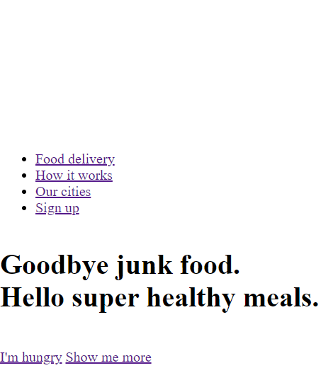
The HTML
Write the HTML codes. The page will probably look hideous with only HTML, but it’s okay. We will style it with CSS
We even can’t see the logo! Use inspect element to check if it exists.
Let’s add a background image to make it better.

Slide 12
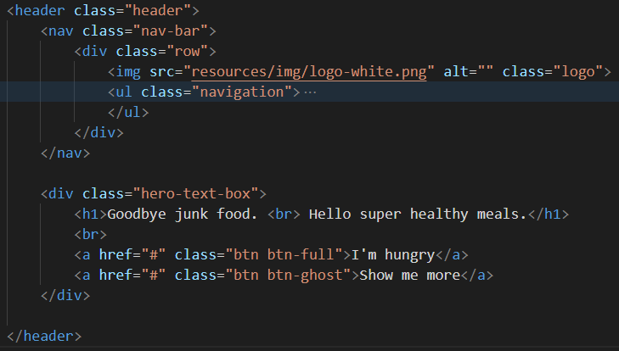
The HTML

Slide 13
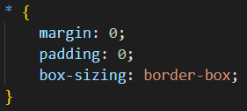
The CSS
Since it is a good practice, we start with this -
We will be using Lato font for this project.

Slide 14
The CSS
To get the font, go to Google fonts and search it up.
Click on the styles that you want. For this project, choose 100, 300, 400.
On the sidebar, copy the generated CSS. Past in index.html in head section.
And configure the CSS like this. This configuration is up to my taste, so feel free to modify it to your liking.

Slide 15
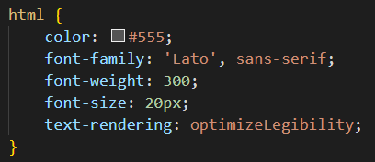
The CSS
With this, we select the HTML tag and have this style applied to all its children -

Slide 16
The CSS
Now select the header element and apply hero.jpg as it’s background image.
The view will improve, but not as much. This is because of the color scheme of the photo. Hence it is always a very good idea to have a linear gradient over any background image that you use.
In CSS, we use linear gradient like this: background-image: linear-gradient( color-stop1, color-stop2);

Slide 17
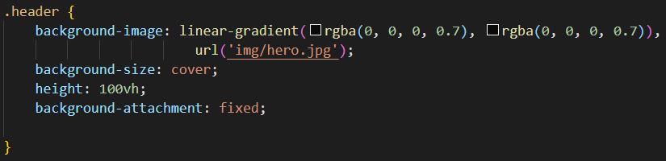
The CSS
The style looks like this -

Slide 18
The header
I have used RGBA (red green blue alpha) colors in linear gradient. Alpha stands for opacity. Alpha = 1 means the color will be fully opaque, while alpha = 0 means it will be fully transparent.
I have used the same color twice in linear gradient because I don’t need a gradient. I want a solid color as the background.
The background image is added with url(‘location’).
Linear gradient falls on top of the background image.

Slide 19
The header
Background size cover fits the image in the background with its aspect ratio intact.
Height 100vh tells the height to be 100% of the view port.
Background attachment fixed keeps the image fixed in the background while we scroll.
The view will have improved, but it’s still awful.

Slide 20
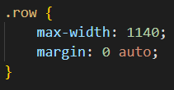
The header
Notice that the elements are sticking to the left side of the screen. Of course we don’t want that.
So we add a max width of 1140 (which should be okay for most computer screens) and set the margin to auto to center horizontally.
In fact, we will be using this class a lot on our website.

Slide 21
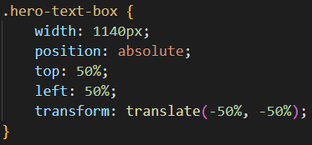
The header
Next, we want the hero textbox aligned in the center of the screen. There is a neat little trick that we can use for this. Play around with the code and see if you can discover what each line of code does -

Slide 22
The header
The text in the hero textbox is really difficult to read. Let’s change its color to white, and text size to something large.
But instead of specifying the text size in px, like 48px, it is better to do font-size: 240%. That way, the size is relative, and it will adapt automatically to different device displays.
Text this large looks very strange. It is actually a rule that larger text should be smaller in font weight. Let’s tone down the font weight to 300.
If the words look too congested, change the word-spacing. 4 looks fine to me

Slide 23
The header
Use text-transform: uppercase to change everything to uppercase.
Resize the logo. Set the height to 100px and width to auto. That preserves the aspect ratio.
Now to style nav items. I have done it using floats. But it should be easier with flexboxes.
Each nav item should be an anchor tag with href=”#”. This makes a dummy link.
Give a transparent bottom border to the anchor tags.

Slide 24

The header
This should happen on hover -
Can you find out the purpose of the transparent border instructed in the previous slide?

Slide 25

The header
This vertical centering should be easy with flexboxes

Slide 26
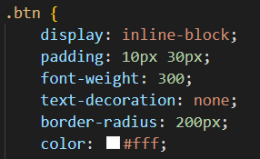

Buttons
All that is left now is to style the link as buttons
Text-decoration: none removes the underline from text
Rest is self explanatory.

Slide 27

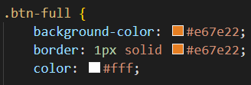
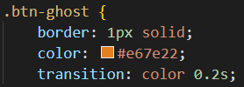
Buttons
You will notice that I have coded the buttons this way -
The reason why I have coded three classes is to keep the similarities in btn class and the dissimilarities in btn-full and btn-ghost.

Slide 28
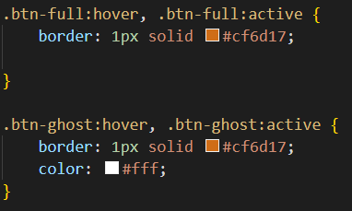
Buttons
This coding style not only reduces duplication, but also encourages code reuse.
For example, I may want more rounded button but with different colors. In that case, those buttons will be able to reuse the class btn.

Slide 29
Finish designing this section

